Slide 1
Campañas de comunicación efectivas y sostenibles
Ciudad de Panamá
22 de Noviembre de 2018
Mayo, 2018
Notes:
Intro title slide:
Title can be about 25 to 50 characters in length (with spaces). Arial Bold 32 pt. The date is adjustable (Arial bold 12 pt.)
Text colors:
The six key Corporate Accountability colors are listed in the “theme colors” dropdown.
Click on “theme colors”, then “more”, and you should see “CA colors” which you can use for your slides.

Slide 2
Agenda:
Introducción.
Corporate Accountability
En Campaña
Planeación Estratégica
Niveles de Influencia
Movilización
10 Cosas (Google)
13 Conclusiones (Forbes)
Notes:
Agenda:
Limit this to 5 points.
Header text in orange is Arial Black 44 pt.
Bulleted points are Arial Regular 20 pt. with less than 50 characters per line (with spaces).

Slide 3
Notes:
End slide:
Fixed logo and tagline.

Slide 4
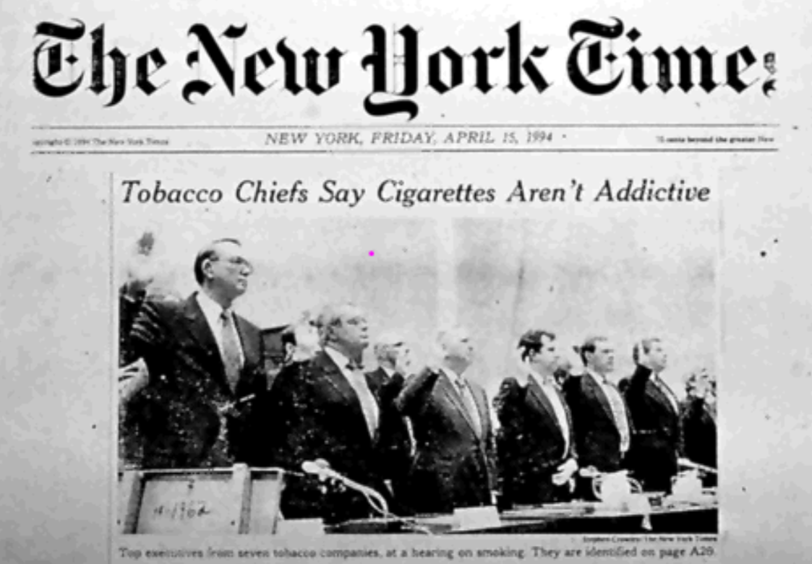
Notes:
End slide:
Fixed logo and tagline.

Slide 6
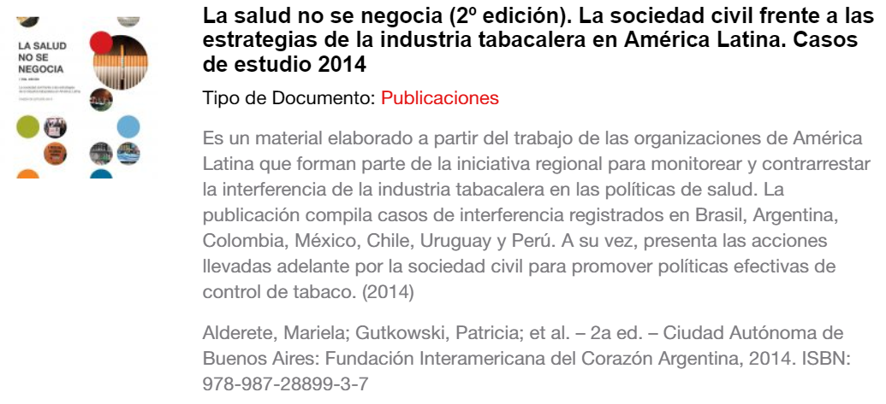
En campaña:

Slide 7
Planeación estratégica
Necesidad
Objetivos
Audiencia
Mensaje
Estímulo
Presupuesto
Asesoramiento
Canales
Planificación
Control
Evaluación
Notes:
A page of bulleted points, with extra text in each bullet:
Page headline or header- uppercase Header in Arial Black 44 pt.
On one to two lines (max 40 characters w/spaces)
Numbered bullets are below that- Numbers and featured words are bolded Arial 18 pt.
Bolding the features words is optional.
The remaining body text is Arial regular 18 pt.
A max of 60 characters (with spaces) per line.
Keep bullet text to one to three lines each, for a maximum of 3 bullets.

Slide 8
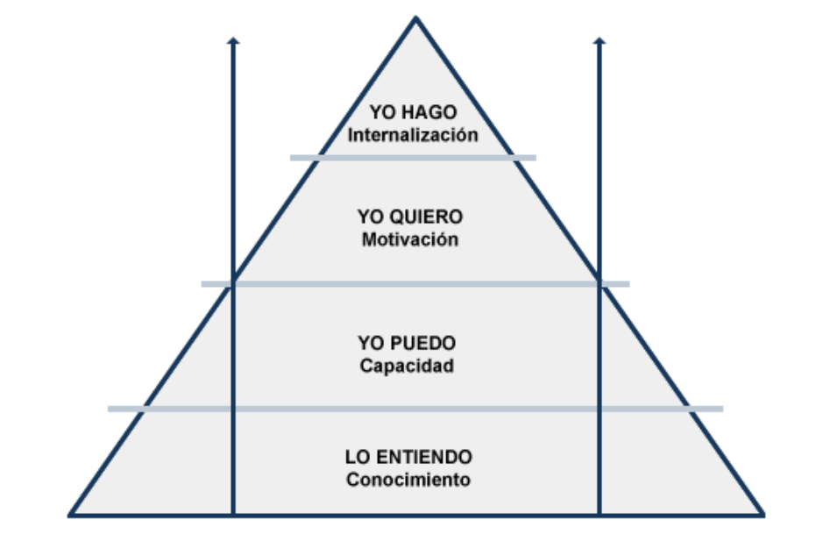
Niveles de Influencia
Fuente http://cv.uoc.edu/UOC/a/moduls/90/90_332/web/main/m4/web/main/m1/2.html
Notes:
Chapter/section outline slide:
A chapter or section name goes at the top. Uppercase text in Arial Black 16 pt. Set in light grey.
Below that is a big orange title or header. Uppercase Header in Arial Black 44 pt. on one to two lines (max 50 characters w/spaces)
Brief bullets are below that: Arial regular 20 pt. 65 characters (with spaces) per line.
Keep bullet text to one line each, for a max of 5 bullets. Less is more ☺

Slide 9
Movilización
Usar las herramientas digitales disponibles (Redes y más)
Cultivar a las audiencias
Crear fidelidad y recompensarla
Hacerse ver, escuchar y entender
Crear contenido e innovar
Informar y entretener
Consolidar un equipo de trabajo
Usar mecanismos de medición
De la generalidad a la especialización
Uso inteligente de los recursos (asesoría)
Alianzas estratégicas
Enfoque honesto - interactivo - Creativo
Compartir y avanzar
Notes:
A page of bulleted points, with extra text in each bullet:
Page headline or header- uppercase Header in Arial Black 44 pt.
On one to two lines (max 40 characters w/spaces)
Numbered bullets are below that- Numbers and featured words are bolded Arial 18 pt.
Bolding the features words is optional.
The remaining body text is Arial regular 18 pt.
A max of 60 characters (with spaces) per line.
Keep bullet text to one to three lines each, for a maximum of 3 bullets.

Slide 10
Tecnología
Notes:
A page of bulleted points, with extra text in each bullet:
Page headline or header- uppercase Header in Arial Black 44 pt.
On one to two lines (max 40 characters w/spaces)
Numbered bullets are below that- Numbers and featured words are bolded Arial 18 pt.
Bolding the features words is optional.
The remaining body text is Arial regular 18 pt.
A max of 60 characters (with spaces) per line.
Keep bullet text to one to three lines each, for a maximum of 3 bullets.

Slide 11
Tecnología
Notes:
A page of bulleted points, with extra text in each bullet:
Page headline or header- uppercase Header in Arial Black 44 pt.
On one to two lines (max 40 characters w/spaces)
Numbered bullets are below that- Numbers and featured words are bolded Arial 18 pt.
Bolding the features words is optional.
The remaining body text is Arial regular 18 pt.
A max of 60 characters (with spaces) per line.
Keep bullet text to one to three lines each, for a maximum of 3 bullets.

Slide 12
Tecnología
Notes:
A page of bulleted points, with extra text in each bullet:
Page headline or header- uppercase Header in Arial Black 44 pt.
On one to two lines (max 40 characters w/spaces)
Numbered bullets are below that- Numbers and featured words are bolded Arial 18 pt.
Bolding the features words is optional.
The remaining body text is Arial regular 18 pt.
A max of 60 characters (with spaces) per line.
Keep bullet text to one to three lines each, for a maximum of 3 bullets.

Slide 13
Tecnología
Notes:
A page of bulleted points, with extra text in each bullet:
Page headline or header- uppercase Header in Arial Black 44 pt.
On one to two lines (max 40 characters w/spaces)
Numbered bullets are below that- Numbers and featured words are bolded Arial 18 pt.
Bolding the features words is optional.
The remaining body text is Arial regular 18 pt.
A max of 60 characters (with spaces) per line.
Keep bullet text to one to three lines each, for a maximum of 3 bullets.

Slide 14
Tecnología
Notes:
A page of bulleted points, with extra text in each bullet:
Page headline or header- uppercase Header in Arial Black 44 pt.
On one to two lines (max 40 characters w/spaces)
Numbered bullets are below that- Numbers and featured words are bolded Arial 18 pt.
Bolding the features words is optional.
The remaining body text is Arial regular 18 pt.
A max of 60 characters (with spaces) per line.
Keep bullet text to one to three lines each, for a maximum of 3 bullets.

Slide 15
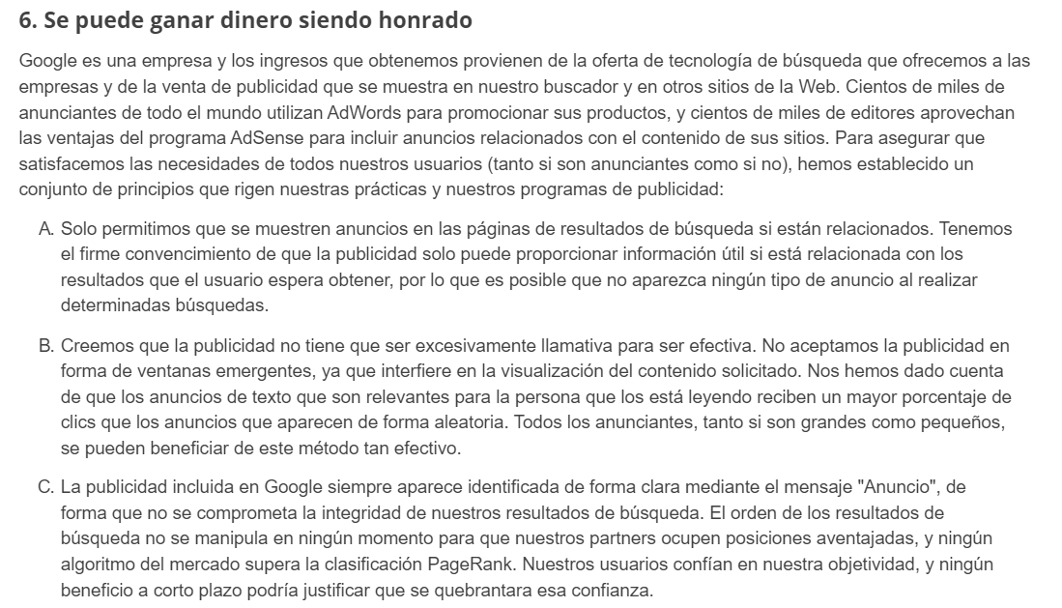
Tecnología
Notes:
A page of bulleted points, with extra text in each bullet:
Page headline or header- uppercase Header in Arial Black 44 pt.
On one to two lines (max 40 characters w/spaces)
Numbered bullets are below that- Numbers and featured words are bolded Arial 18 pt.
Bolding the features words is optional.
The remaining body text is Arial regular 18 pt.
A max of 60 characters (with spaces) per line.
Keep bullet text to one to three lines each, for a maximum of 3 bullets.

Slide 16
Tecnología
Notes:
A page of bulleted points, with extra text in each bullet:
Page headline or header- uppercase Header in Arial Black 44 pt.
On one to two lines (max 40 characters w/spaces)
Numbered bullets are below that- Numbers and featured words are bolded Arial 18 pt.
Bolding the features words is optional.
The remaining body text is Arial regular 18 pt.
A max of 60 characters (with spaces) per line.
Keep bullet text to one to three lines each, for a maximum of 3 bullets.

Slide 17
Tecnología
Notes:
A page of bulleted points, with extra text in each bullet:
Page headline or header- uppercase Header in Arial Black 44 pt.
On one to two lines (max 40 characters w/spaces)
Numbered bullets are below that- Numbers and featured words are bolded Arial 18 pt.
Bolding the features words is optional.
The remaining body text is Arial regular 18 pt.
A max of 60 characters (with spaces) per line.
Keep bullet text to one to three lines each, for a maximum of 3 bullets.

Slide 18
Tecnología
Notes:
A page of bulleted points, with extra text in each bullet:
Page headline or header- uppercase Header in Arial Black 44 pt.
On one to two lines (max 40 characters w/spaces)
Numbered bullets are below that- Numbers and featured words are bolded Arial 18 pt.
Bolding the features words is optional.
The remaining body text is Arial regular 18 pt.
A max of 60 characters (with spaces) per line.
Keep bullet text to one to three lines each, for a maximum of 3 bullets.

Slide 19
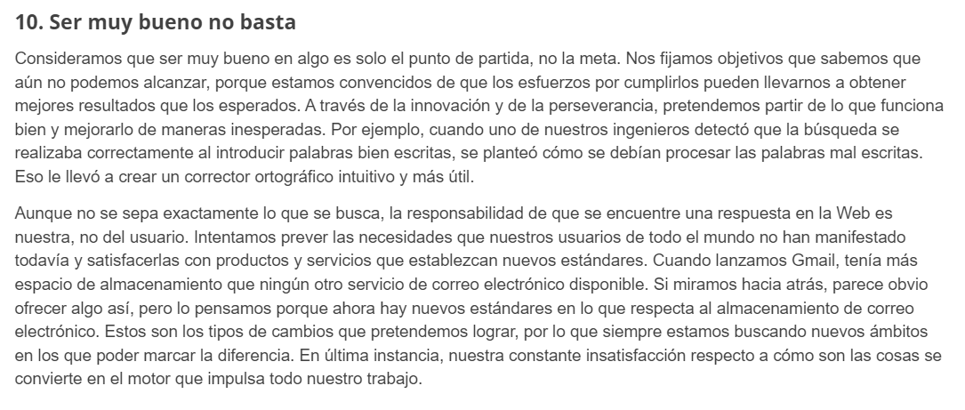
Tecnología
Notes:
A page of bulleted points, with extra text in each bullet:
Page headline or header- uppercase Header in Arial Black 44 pt.
On one to two lines (max 40 characters w/spaces)
Numbered bullets are below that- Numbers and featured words are bolded Arial 18 pt.
Bolding the features words is optional.
The remaining body text is Arial regular 18 pt.
A max of 60 characters (with spaces) per line.
Keep bullet text to one to three lines each, for a maximum of 3 bullets.

Slide 20
13 Conclusiones (Forbes)
Prueba, mide y aprende rápido.
Simplifica tus canales.
Aplicar el marketing ágil.
Crear asociaciones que compartan el costo.
Actualizar contenido y campañas exitosas.
No concesiones y ser creativo
Apalancarse en la Comunidad
Hazlo en casa y comprueba la optimización de los sistemas de búsqueda
Priorizar y secuenciar
Ir a lo granular
Centrarse en contenido “perenne” de alto valor
Pregunte a los usuarios por sus revisiones
Aprovechar la incidencia para sensibilizar
https://www.forbes.com/sites/forbescommunicationscouncil/2017/08/31/13-ways-to-create-an-effective-marketing-campaign-on-a-tight-budget/#19426f5f4605
Notes:
A page of bulleted points, with extra text in each bullet:
Page headline or header- uppercase Header in Arial Black 44 pt.
On one to two lines (max 40 characters w/spaces)
Numbered bullets are below that- Numbers and featured words are bolded Arial 18 pt.
Bolding the features words is optional.
The remaining body text is Arial regular 18 pt.
A max of 60 characters (with spaces) per line.
Keep bullet text to one to three lines each, for a maximum of 3 bullets.

Slide 21
Notes:
Thank you slide.
Fixed in place.

Slide 22
Jaime Arcila Sierra
Coordinador para América Latina
jarcila@CorporateAccountability.org
Oficina Regional para América Latina
Cra. 11A 90-16 OFI 509
Bogotá, DC. Colombia
CorporateAccountability.org
Notes:
Optional end slide with contact info

